Slide 1

How has Airline Safety Improved
By Matthew Latondresse

Slide 2
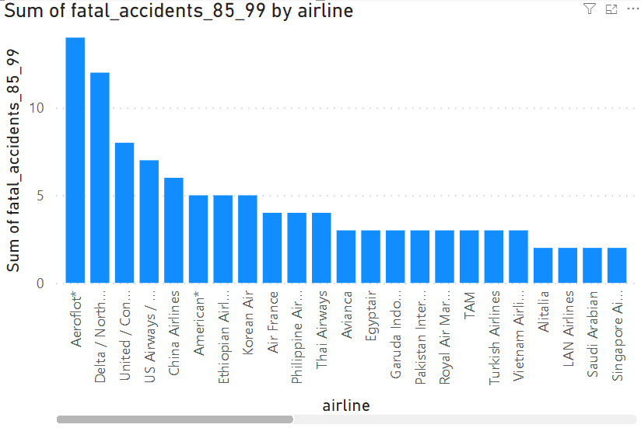
Number of Accidents from 1985-99
To properly relay to the public just how safe Airlines have become. Let us examine how dangerous Airlines were.
Examining from 1985 to 1999 we can see that Aeroflot had the most recorded incidents at 14 total incidents. This is followed by Delta at 12. Following these two many companies had less then 10 fatal accidents.

Slide 3
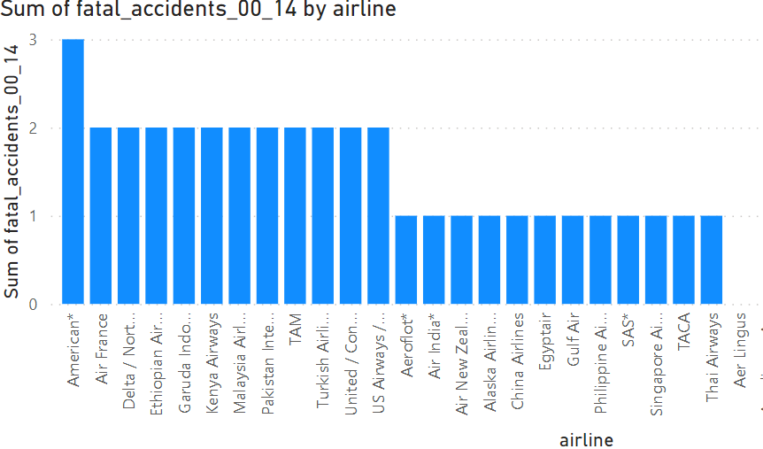
Number of Fatal Accidents 2000-14
Now comparatively, we can see that the number of fatal accidents has gone down significantly. American is currently at the highest with 3 fatal accidents.
Most companies had 2 or less over this span of 14 years which is less than half of most companies from the previous 14 years.

Slide 4
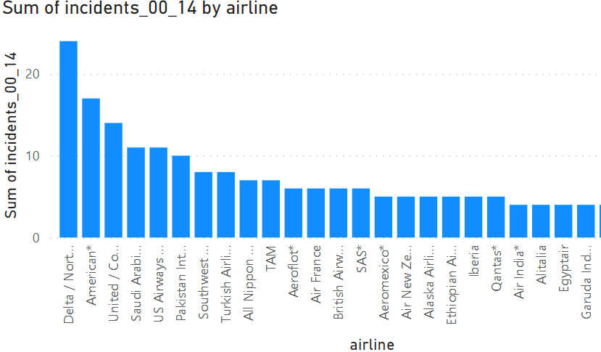
How Many Incidents have Occurred?
Delta Airline had a total of 24 total incidents that occurred between 2000-2014. Going back to the previous graph we can see that out of these 24 incidents only 2 of them resulted in any fatalities.

Slide 5
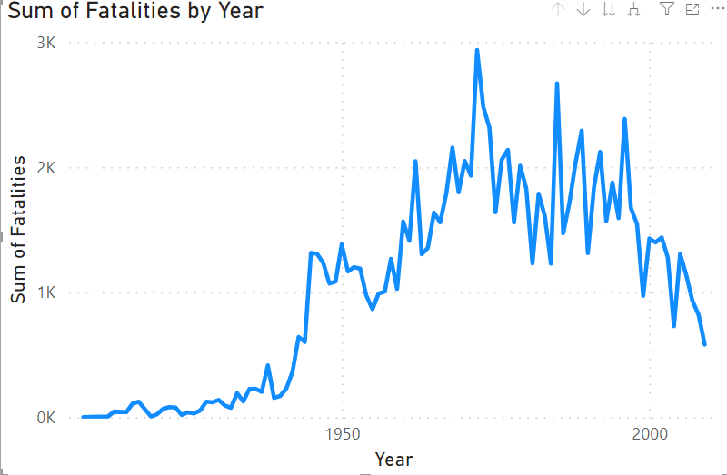
The Amount of Fatalities
As shown by this graph, sense the peak in 1972 of 2937 fatalities. We have been trending downward in the number of fatalities each year. As of 2009, we only had a total of 581 fatalities. This is an 80.22% increase in the safety of Airlines.

Slide 6
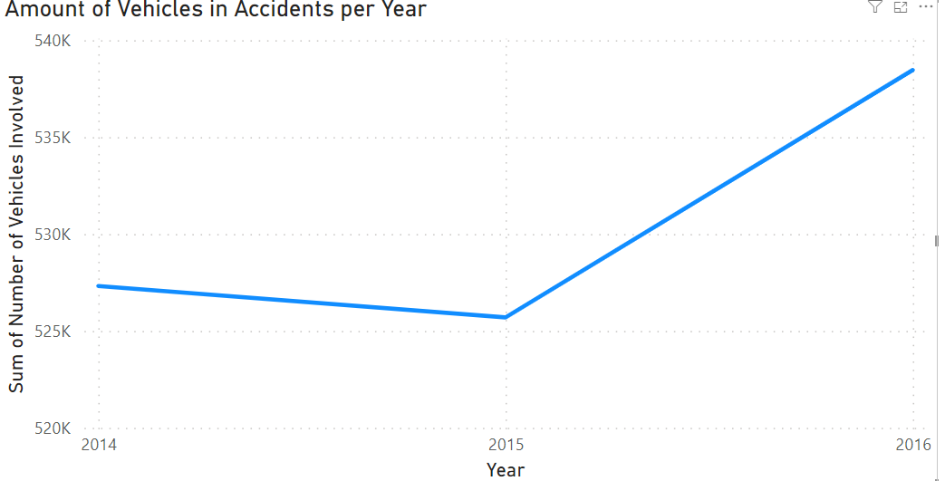
How Does This Compare to Motor Transport?
Looking at another popular form of transportation, we can examine just how safe Airlines are comparatively. Just from examining a 2-year period we can already see that the amount of Motor Vehicle accidents is astronomically higher. In 2016 alone there were 538,461 accidents.

Slide 7
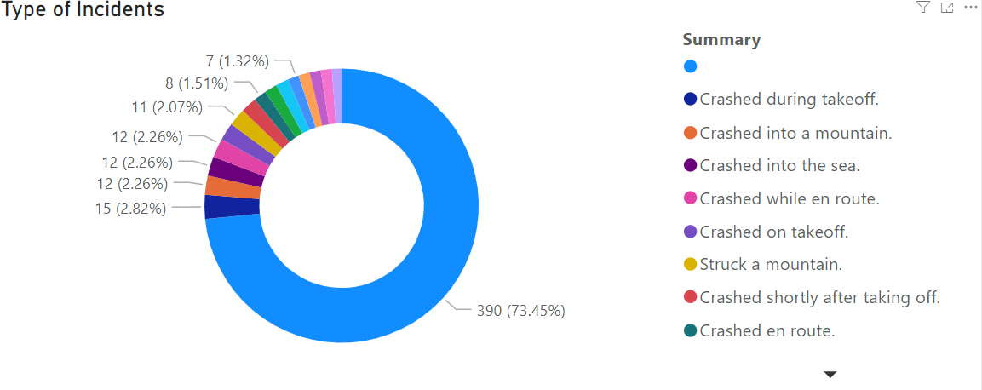
Where are These Incidents Occuring?
Looking over the reports a significant portion of the incidents that are affecting Airlines do not have a specific reason listed. But following that we can see that 15 of the total incidents that have occurred during take-off.

